Slide 1
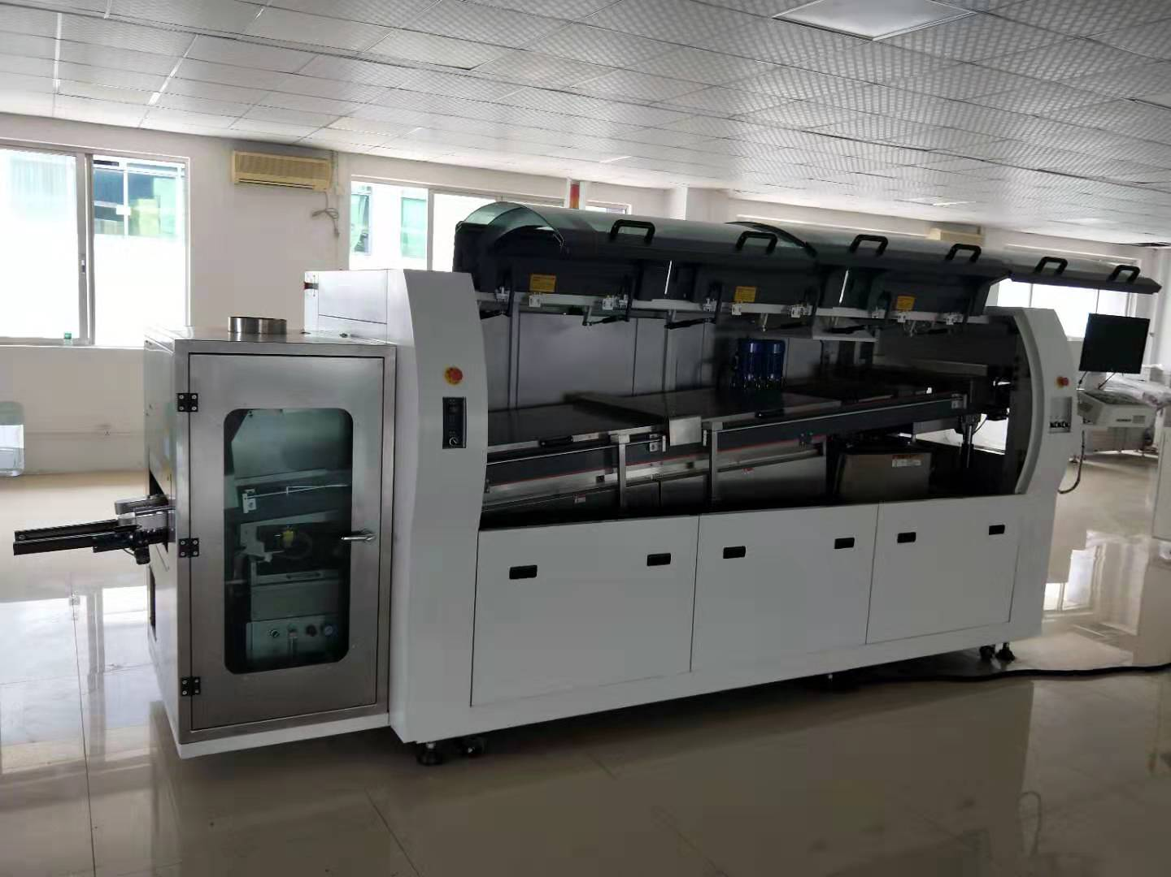
SWS450M Wave soldering machine (Big board solutions)
External flux conjunctions
super energy saving
Big Board Support
PCB Width:
Max.50~450mm

Slide 2
SWS450M Wave soldering machine (Big board solutions)
Machine Specification
Model | SWS450M | Solder pot type | 4th adjustable
PCB width | Max.50~450mm | Heating technology | Matrix straight heating, heating efficiency up to 95%
PCB convey height | 750±50mm | Solder pot temp. | Room temp.~300℃、accuracy±1-2℃
Conveyor speed | 1500-1800mm／Min | Solder pot temp. accuracy | ±10
Angle | 3~7 degree | Finger types | Strong dicolpate finger/customized
Component height limit | Max.100mm | Solder bar adding way | Manually
Wave height range | 0~18mm keep steady | Temp. control | P.I.D+SSR
Wave quantity | 2 | Machine control | PLC+PC
Preheating length | 1800MM | Width adjust | Manually/motorized
Preheating zone | ４zones | Flux adding way | Automatically
Conveyor direction | Left to right | Flux flow rate | 10~100ml/min
Preheat power | 8KW | Spray method | Step motor+A-100 nozzle
Preheat temp. | Room temp.~250℃ (adjustable) | Flux recycle | Tray to hold
Heating model | Hot air | Electricity | 3P 5 wires 380V/3P 220V
Solder bar type | Lead-free | Total power | Max.22kw
Solder pot power | 14kw | Normal running power | Approx.3-5kw

Slide 3
SWS450M Wave soldering machine (Big board solutions)
Solder pot capacity | Approx.480kg | Air supply | 4~7KG/CM2
Solder pot material | Cast iron | Dimension | 3900*1600*1730(Relocation spray Dimension 1500*1350*1550mm)
Weight | Approx.1500kg
Machine cover
Structure | Streamline cover design, the frame is made of thick square tube, the cover is made of 2mm steel plate. There are totally 6 wheels to move the machine easily.
Front door structure | Fully enclosed glass door, transparent，pneumatic holder to support, ensure the operating and repairing space.
Machine top | Anti-explosion lamp
Surface treatment | Painted with white color
Flux spraying
Spray nozzle | Spray range:20~65mm,adjustable，nozzle height: 50~80mm adjustable，max. flow rate:100ml／min
Air circuit | Acid and alkali resistant air pipe, the brand is SMC from Japan.
Nozzle moving system | Step motor to drive, Mitsubishi PLC, with proximity switch and entrance sensor to control, according to the coming PCB’s speed and width, the spraying system can detect and starts to work.
Flux recycle system | Tray to hold the waste water and flux, can be draw out easily, make maintenance very convenient.
Flux exhaust system | Exhaust system：stainless steel mesh frame+ double layers filter，recycle the flux to maximum.
Isolated air curtain | Air pressure type knife, blow the redundant flux into the recycling box, to avoid the flux to enter into the preheating zones, ensures the safety.
Spraying box structure | Made of full stainless steel, easy to clean and repair. Anti-corrosion, very durable.

Slide 4
SWS450M Wave soldering machine (Big board solutions)
Preheating
Preheating zone quan. | Preheating length is 1800mm, divided into 4 sections, supply abundant adjusting space, very good for big PCB and complicated PCB. Reduce the heat impact on PCB, improve the production efficiency.
Temp. control method | Mitsubishi temp. collecting module, PID is very precise and stable.
Heating parts | The heaters are imported from Taiwan, heat up very fast, with long life, small thermo lag; The heat is even in the zones.
Preheating power | 22kw
Install mode | The heating module adopts drawer design, easy to replace and repair, make the maintenance very convenient.
Transmission
Rail | Made of aluminum, wear resistant and without distortion.
Rail parallelism | Width adjusting accuracy less than 0.2mm
Width adjust | Manually/motorized
C/V speed setting unit | Min.1mm／min 0-1800mm／min
C/V speed variation range | Electric closed-loop control, within 0-10mm／min
Conveying motor | Panasonic motor from Japan

Slide 5
SWS450M Wave soldering machine (Big board solutions)
Solder pot
Low oxidization design | High quality solder pot, the heat is very steady. Adopts liquid solder flow design, reduce the impact oxidization, especially for small PCB.
Economical running | Reduce the power consumption
Moving method | Motorized
Wave adjustable height | 0-18mm
Wave motor | TCG motor from Taiwan，adjust the wave height with frequency conversion.
Preheating parts | Adopts the stainless steel heaters from Taiwan, with long life and power saving up to 40% daily.
Cooling
Cooling method | Adopts high power centrifugal fan, reduce the air bubble and solder pad stripping
Automatic finger cleaning
Imported premium pump, can wash the fingers from both side. Propyl alcohol to clean and can be recycled.
Control software
★Automatic alarm function for failure:：thermocouple abnormal，temp. too high or too low；if preheating system or solder pot is abnormal,the heating stops.
★Preheating temp., solder pot temp., conveyor speed, spraying and cooling can be controlled separately.
★One week automatic power on/off setting （three times one day）
★The emergency stop are in front, rear of the machine, press them in case of any emergency.

Slide 6
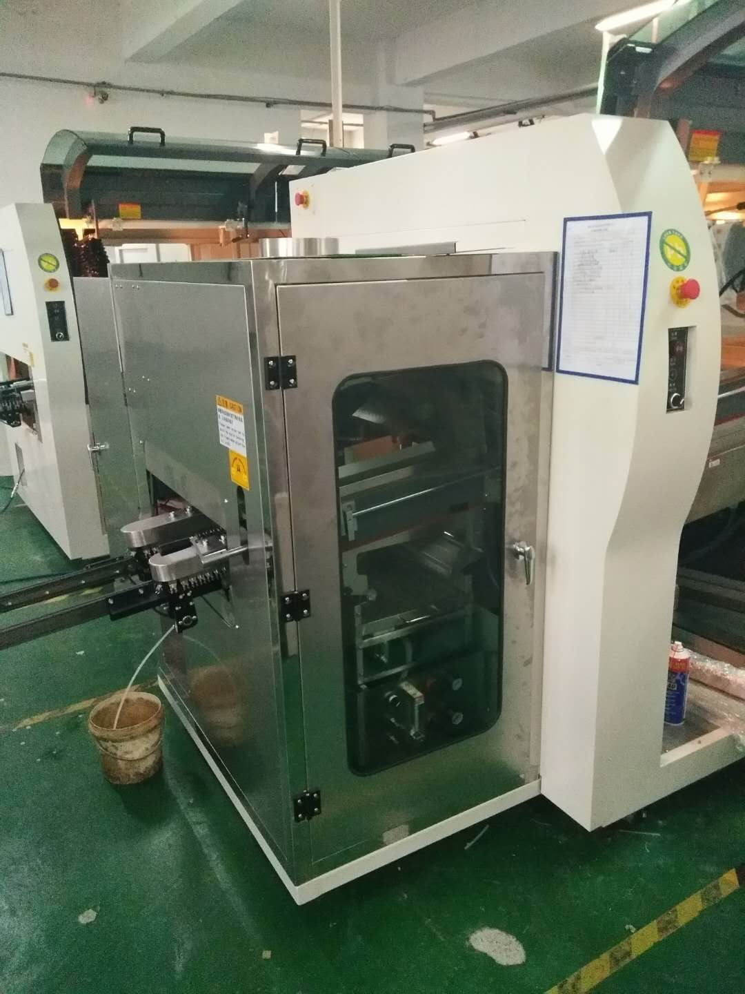
SWS450M Wave soldering machine (Big board solutions)
Titanium finger with ball structure
No frictional resistance
No jitter
Heavy board support

Slide 7
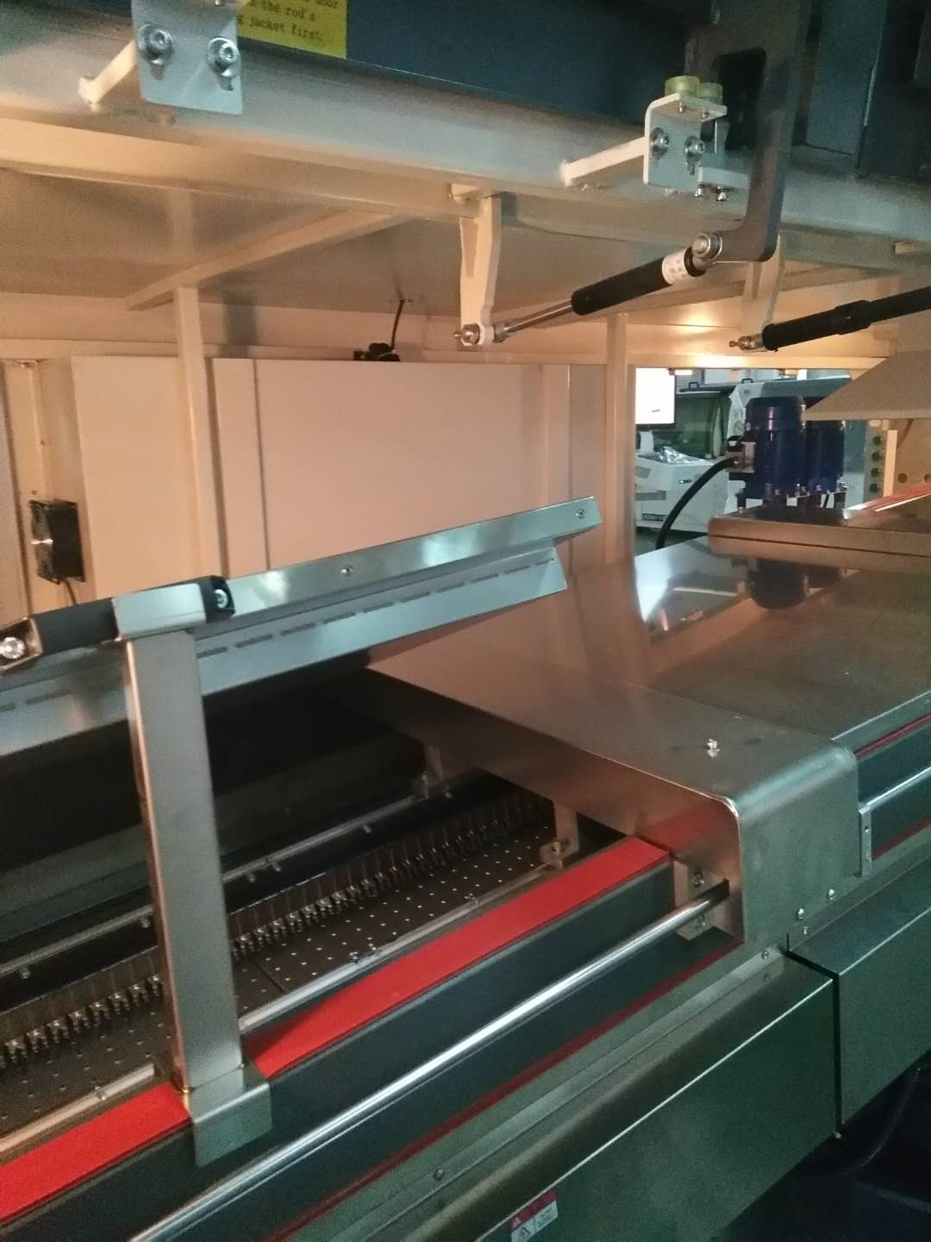
SWS450M Wave soldering machine (Big board solutions)
4 preheating zone
Stainless steel room
Improving soldering quality
Stable processing

Slide 8
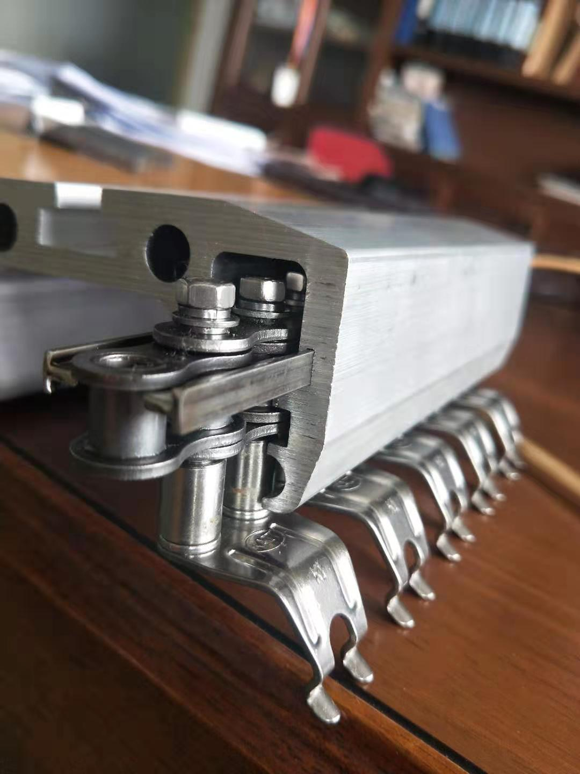
SWS450M Wave soldering machine (Big board solutions)
Stable transport guide
Design by best quality of aluminum profile
Long life-cycle

Slide 9
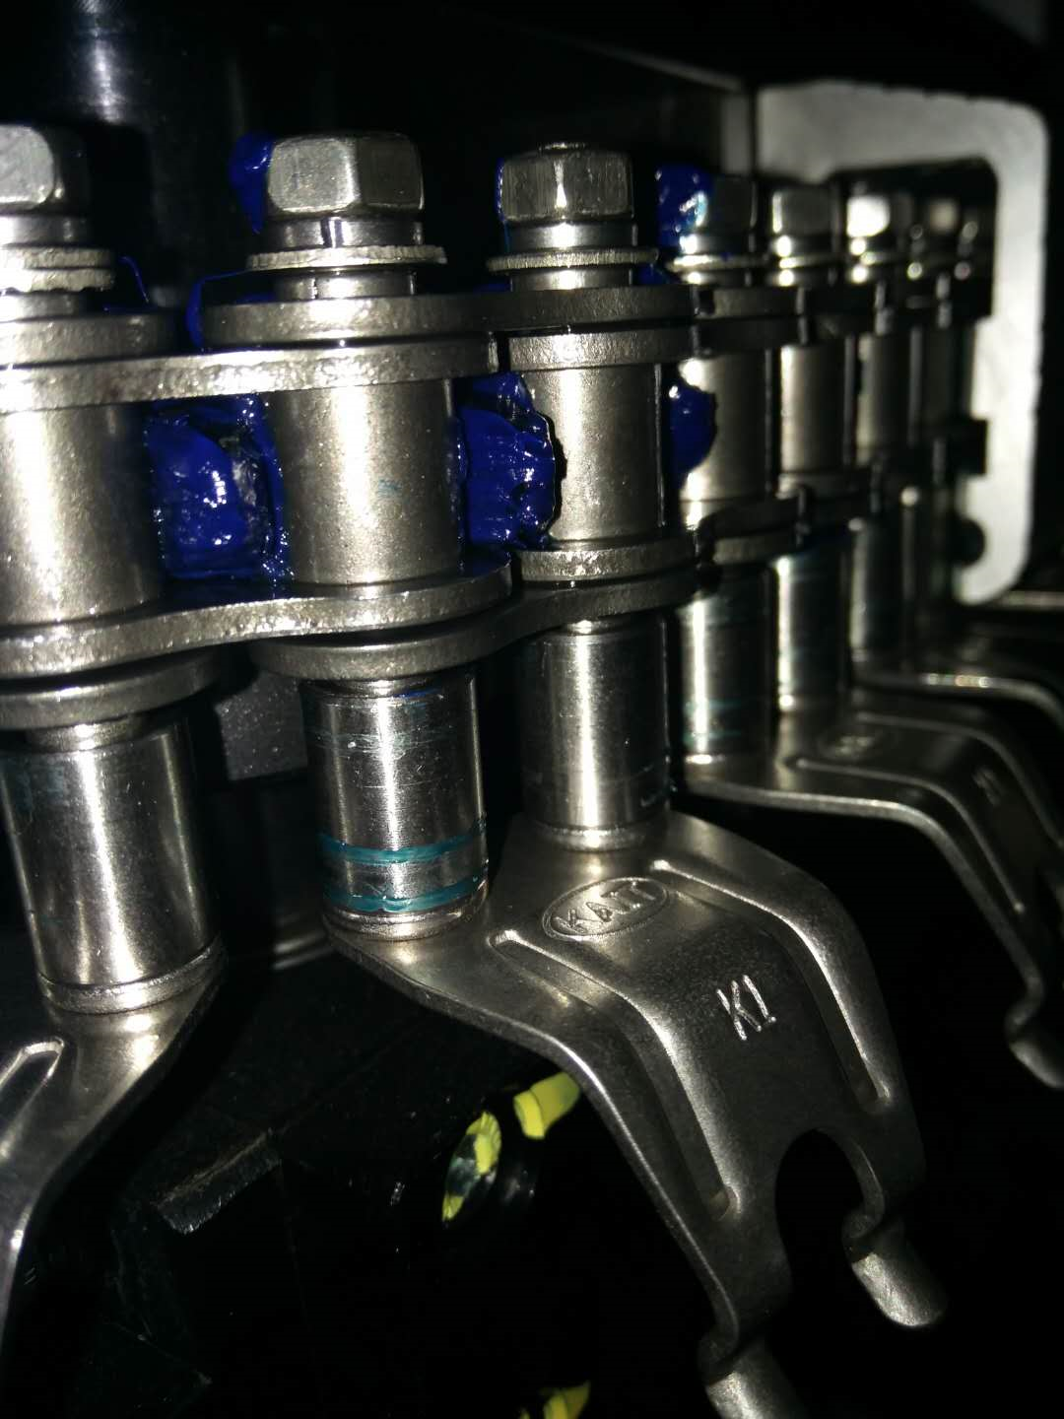
SWS450M Wave soldering machine (Big board solutions)
titanium finger with ball structure
no frictional resistance
no jitter
Heavy board support
titanium finger with ball structure
no frictional resistance
no jitter
Heavy board support

Slide 10
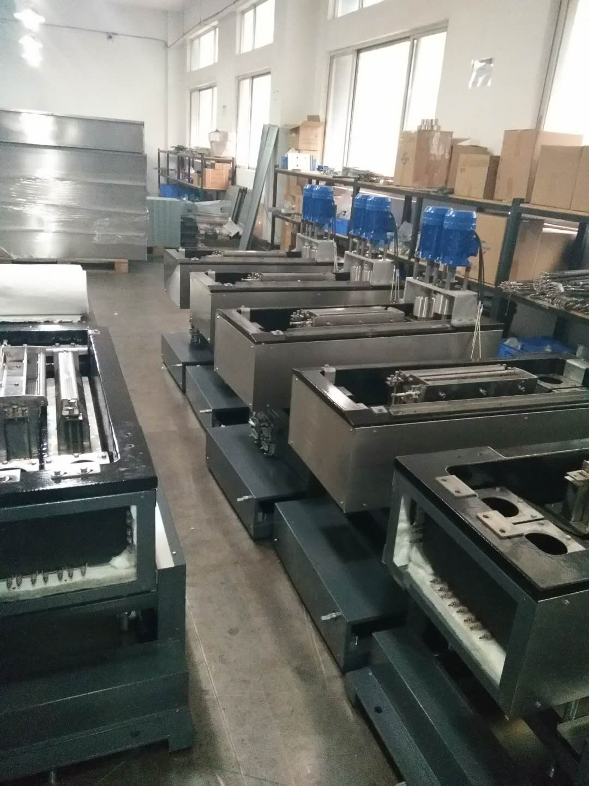
SWS450M Wave soldering machine (Big board solutions)
DI (Ductile Iron) Solder pot
or Titanium alloy solder pot
Titanium alloy nozzle

Slide 11
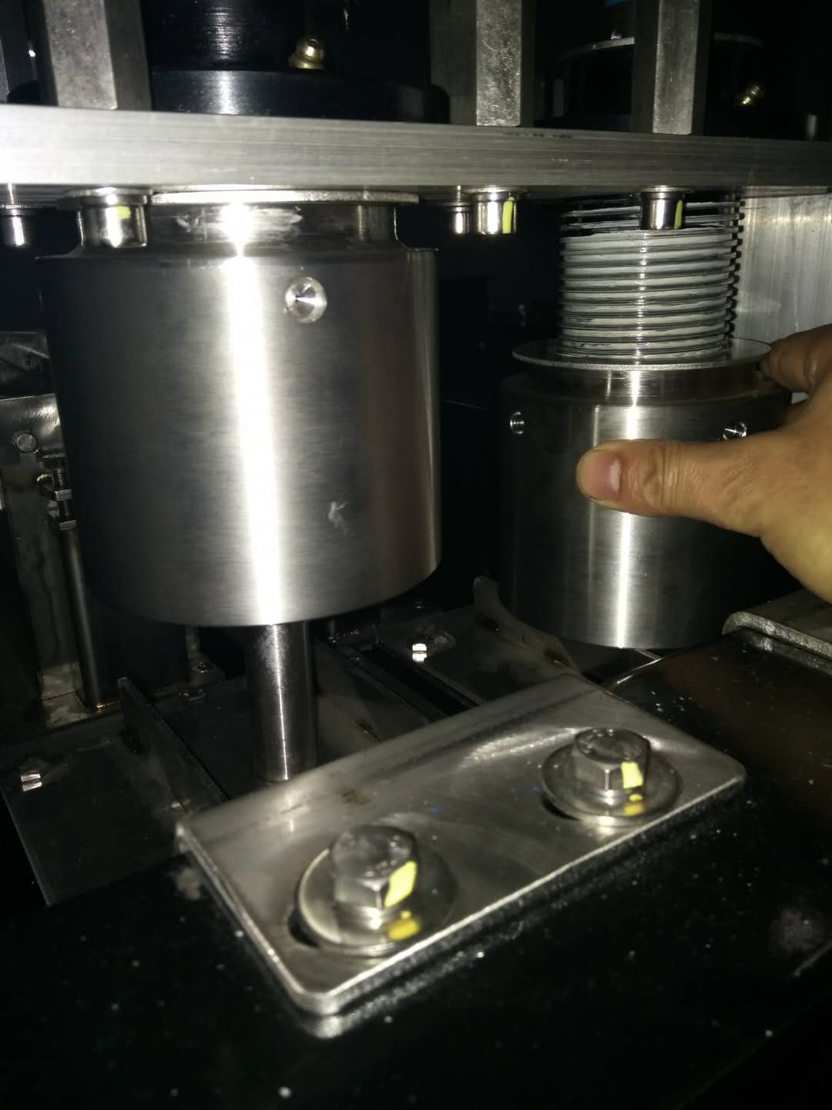
SWS450M Wave soldering machine (Big board solutions)
Spiral vacuum oxidation-proof sleeve
Saving solder tin
Improving Anti-oxidation function

Slide 12
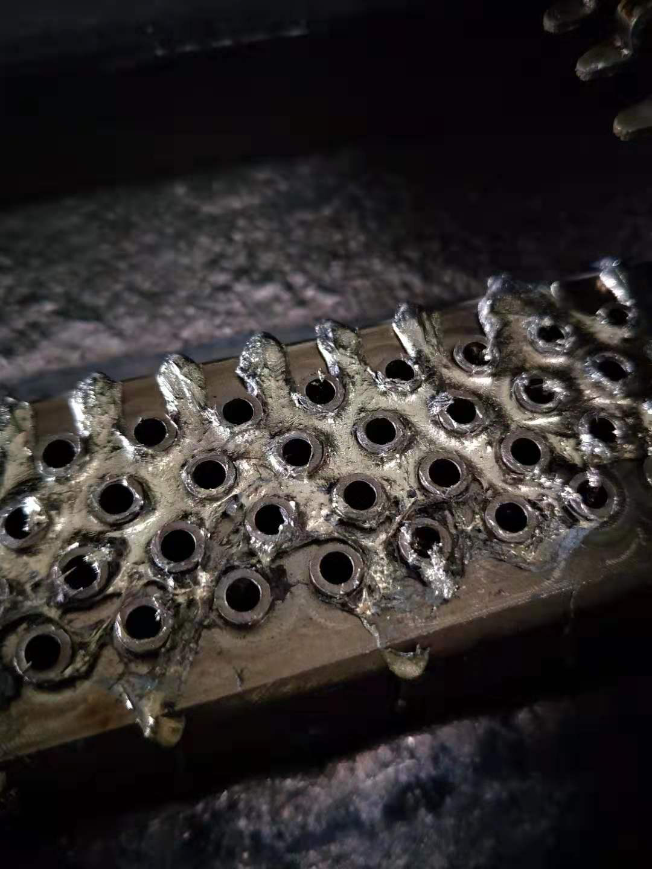
SWS450M Wave soldering machine (Big board solutions)
The 6mm cylindrical etching nozzle
Turbulent wave
Enhances the impact force of the tin
Improving soldering quality for density SMT

Slide 13
SWS450M Wave soldering machine (Big board solutions)
4 preheating zone
Stainless steel room
Improving soldering quality
Stable processing

Slide 14
Comparison SWS450M vs JT SE350
Model | SWS450 | JT SE-350M
1,Flux spray system | The spray box has a modular design, which can be extracted as a whole, and is more convenient for maintenance and maintenance. The frame body structure is adopted in the box body to ensure the uniformity, stability and longevity of the spray for long-term use. 2. The spray system is driven by the tank chain of the placement machine, and the operation is more stable. | The spray box has a modular design, which can be extracted as a whole, and is more convenient to maintain and maintain. The hardware of the box is made of metal bending parts (3MM stainless steel plate bending). The long-term uniformity of spray uniformity, stability and service life of the equipment is not used for a long time.
 | The spray system is driven by a tank chain that is transported by a placement machine, and the operation is more stable. | The spray system is driven by traditional transportation methods and is unstable for a long time.
2，Preheating system | The standard configuration of 4 sections of micro-hot air (customizable) can be customized without any cost. | Standard configuration of 3 sections of hot air.
 | Preheating system insulation around the insulation layer, more energy saving | Preheating system part of the insulation layer insulation, non-four-sided insulation, power consumption

Slide 15
Comparision SWS450M vs JT SE350
Model | SWS450 | JT SE-350M
3，Transportion System | The patented design does not shake, does not jam, and the guide rail is invariant. The rail accessory replacement only needs to replace the steel strip on the inner side of the guide rail, and the guide rail has no wear. The conveyor chain does not need to be refueled. | The heavy plate will shake and become stuck. The transportation chain needs to be regularly heated with high temperature. Maintenance and replacement of the butter will not cause the card to die. Long time will wear the rail
4, Solder pot system | The peak level is like a mirror, the peak height is 15MM, and the peak shape can be adjusted arbitrarily. The function of the tin slag is automatically collected. The patented design of the wave nozzle (large impact force, better tin) is used to reduce welding defects such as continuous welding. | The traditional nozzle design, the peak is not stable above 10MM, the shape of the peak is not adjustable, and there is no automatic collection of dross.
 | Double-wave tin slag for about 10 hours 1.5KG (below 10MM), a wave of about 0.7KG / 12 hours | Double-wave tin slag for about 10 hours 4KG (below 10MM), a wave of about 1.5KG / 12 hours
5，Board input connection | Combined with Taiwan's design, Lite-On specifies the use of this structure, no card board, stable connection, no gap | using the traditional structure, easy to board here
6,Others | 1,The bottom of the stove is also made of stainless steel for easier maintenance。2,Patented portable anti-oxidation cover design, can be completed in 5 minutes during production | Traditional oxidizer design, 4-8 hours of disassembly in production (requires discontinuation)。

Slide 16
WELCOME INQUIRY
Please visit
www.smthelp.com
Find us more
https://www.facebook.com/autoinsertion
Know more our team
https://cn.linkedin.com/in/smtsupplier
Welcome to our factory in Shenzhen China
See more machine working video, please Youtube
Auto Insertion
Google
Auto+insertion, to get more information
Looking forward to your email
info@smthelp.com

